Slide 1
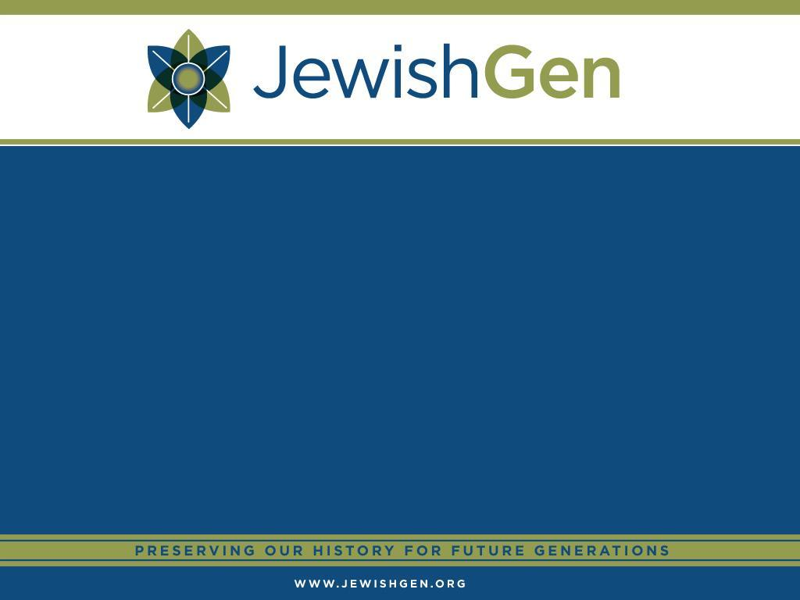
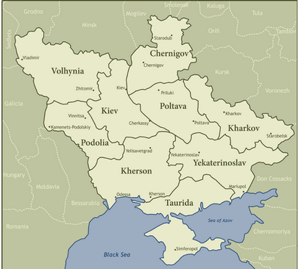
Notes:
*

Slide 2
Ukraine SIG Discussion Group Grew:
3966 on 1 Aug 2017
4155 on 1 Aug 2018

Slide 3
Town Leaders:
Since we met in Orlando (gosh that seems like so long ago), we have added 15 Town Leaders and 12 new KehilaLinks pages have gone up for Ukraine SIG. There are many fairly large towns in Ukraine that still do not have Town Leaders. With new records coming available from the Mormons and especially, the efforts of Alex Krakovsky, we need more Town Leaders to help organize projects to transcribe records and get them into the JewishGen Ukraine database.
Many thanks to Chuck Weinstein who is our Towns Director

Slide 4
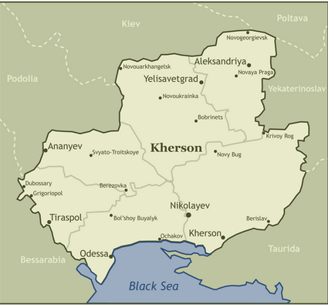

Slide 5
Odessa
Huge thanks to Harvey Kabaker for his work in liaising with Family Search to arrange for Ukraine SIG to have access to the All Russian 1897 Census for Odessa
And to Ariel Parkansky for arranging for volunteer translators and for managing the project:
There are 67,000 pages
About 600 pages have been translated and transcribed resulting in 1,644 lines of information

Slide 6
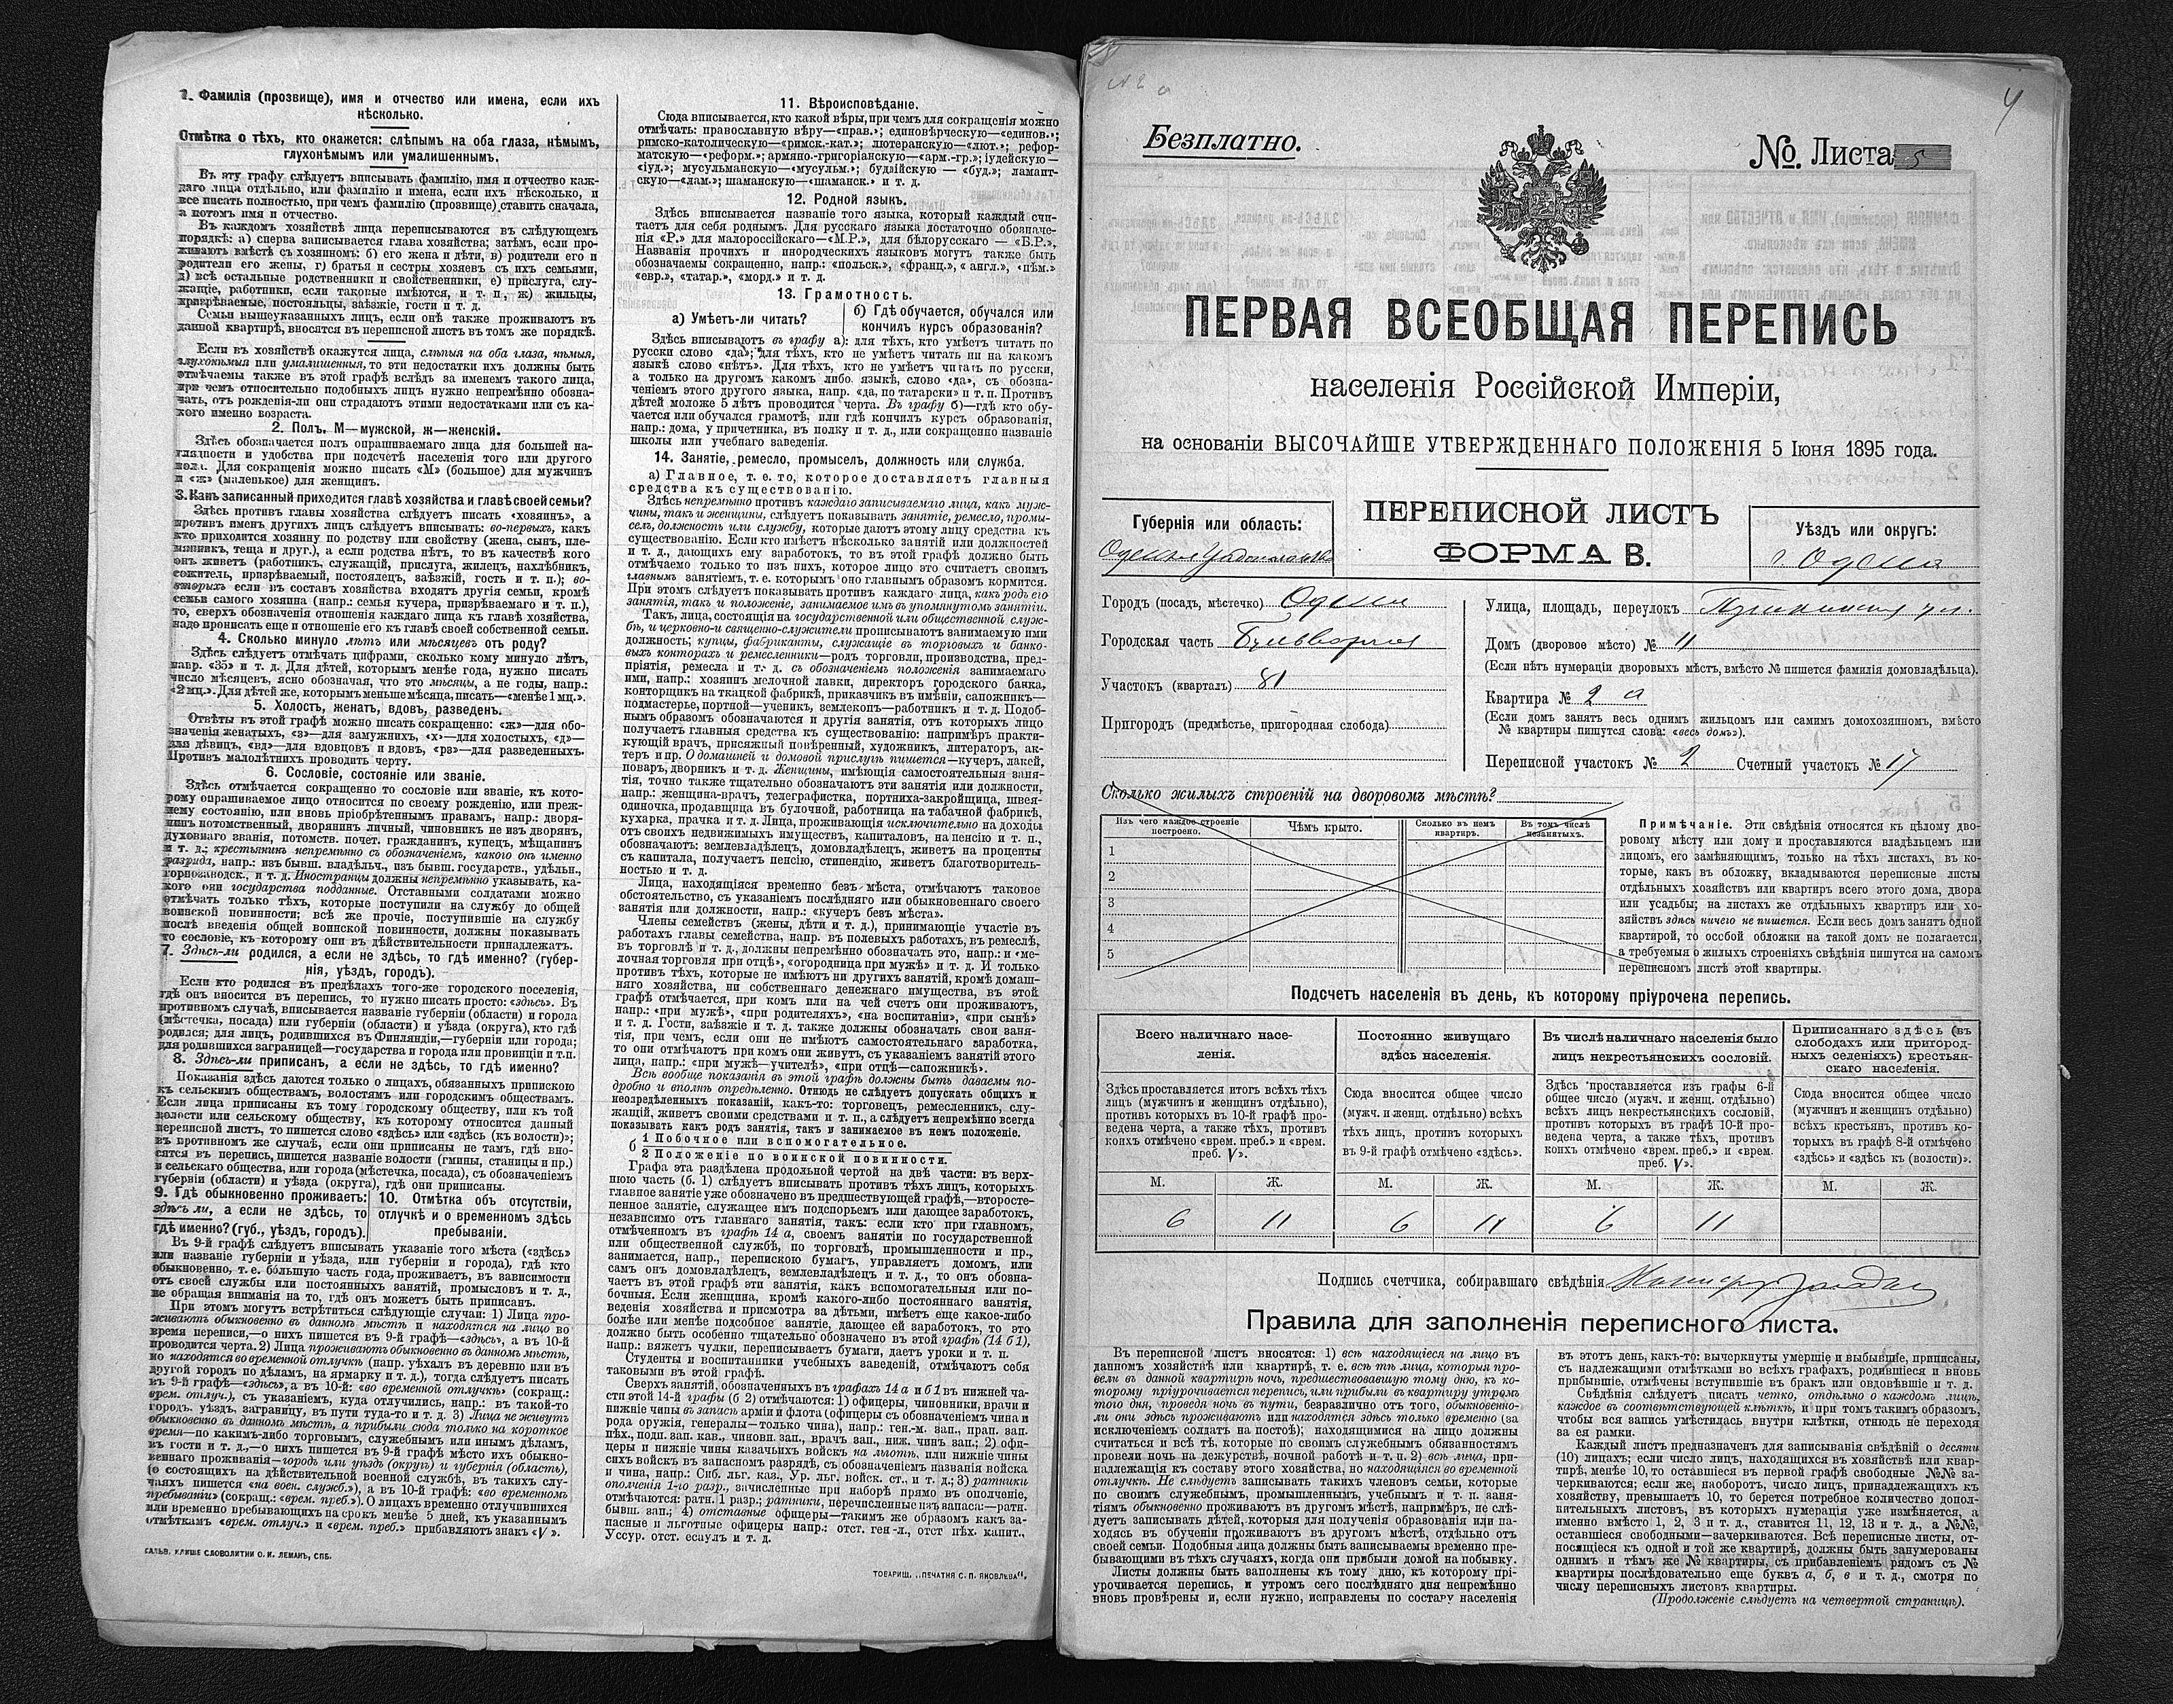

Slide 7
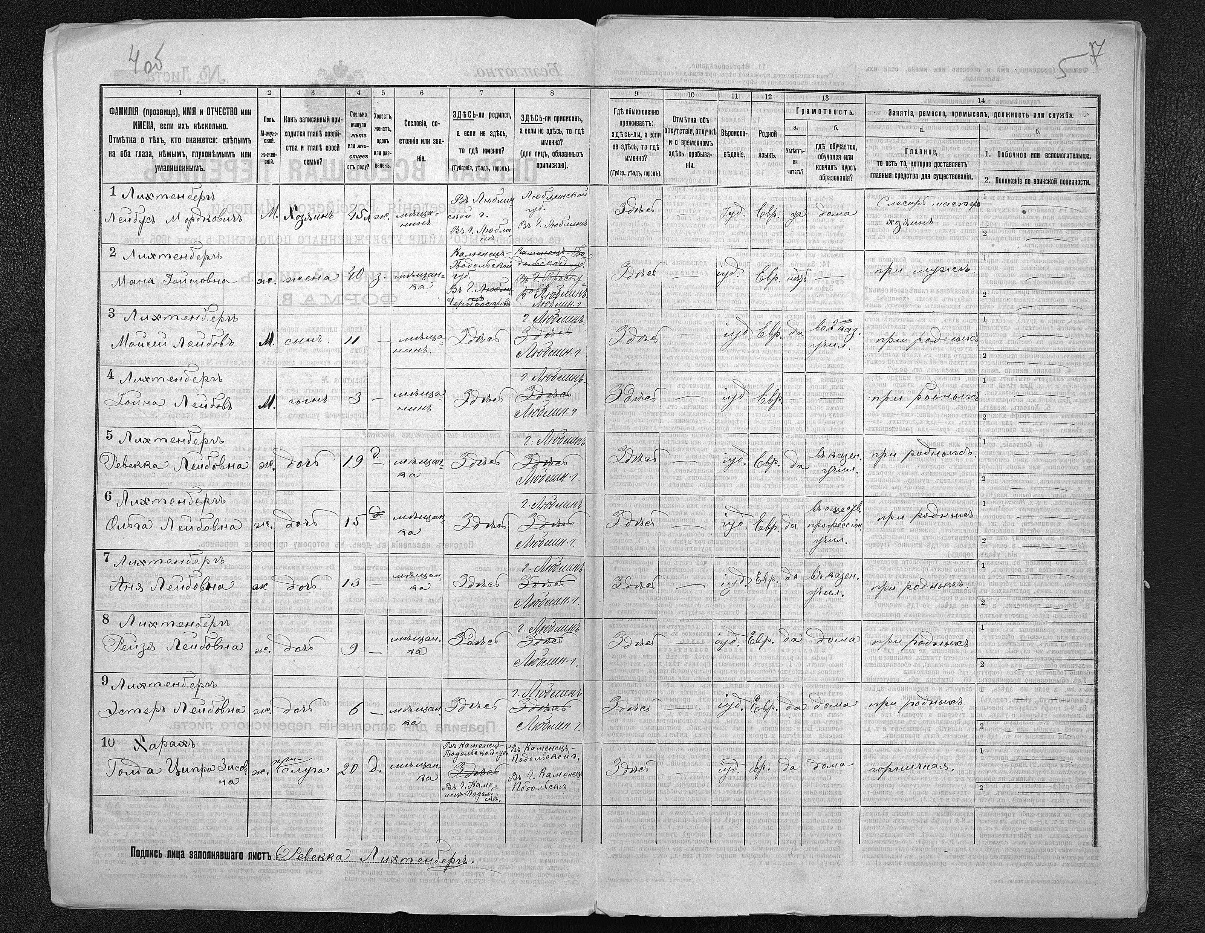

Slide 8
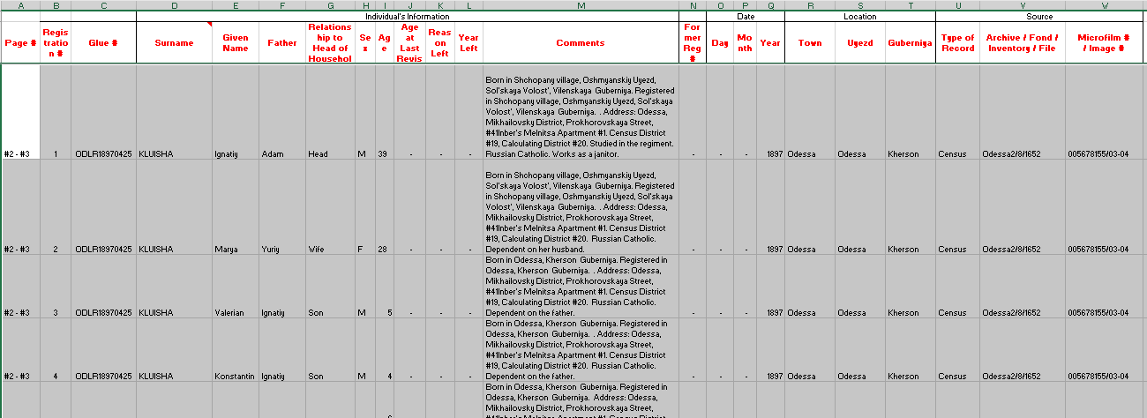
What does the transcription look like?

Slide 9
What is a Revision List?
The Ревизские сказки — Reviskie Skazki (Revision Lists) — were conducted in territories ruled by the Russian Czar in the 18th and 19th centuries. Revision lists were census lists used to levy a poll tax enumerated individuals/families subject to taxation and identified men to draft into the army. These lists provide social estate, age, full name, place of birth, residence and presence of children of both genders. Some items include receipts, correspondence, announcements and other documents pertaining to the revision. Some lists contain only Jewish records; others may have only several pages dedicated to Jews. All of the lists are in Russian and handwritten using the Cyrillic alphabet.
There were ten known major Reviskie Skazki taken in Russian Empire. The project translating/transcribing Ukraine Lists began in 2013, using records microfilmed by the LDS Family History Library and lists obtained directly from Archives in Ukraine and from documents obtained from the Central Archives of the History of the Jewish People in Jerusalem (CAHJP).

Slide 10
What Information is on a Revision List?
Registration # — an assigned family number for a particular town's registry. All family members have the same registration number.
Surname, Given Name
Father — Father's given name (derived from the patronymic).
Relationship to Head of Household
Sex — "M" for male, "F" for female, Age
Age at Last Revision — generally only for men.
Reason Left, Year Left
Comments — includes the status of a family: Merchant, Middle class, Farmer, from military, etc. It also may specify when the family registered for the town, and occasionally includes information about where they came from. It may also contain an address.
Uyezd — district
Gubernia — province

Slide 11
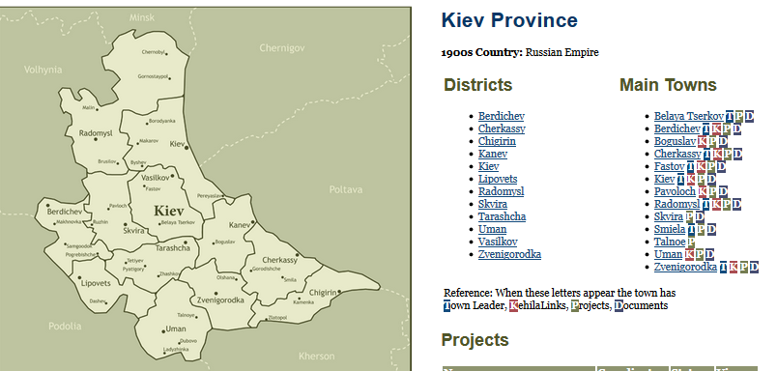

Slide 12
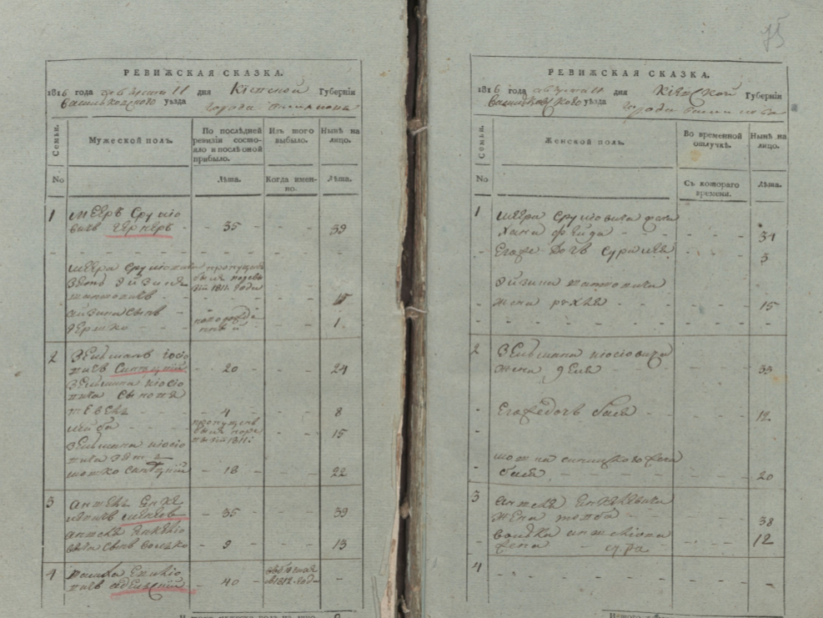

Slide 13
1816 Belaya Tserkov Revision List
Many thanks to Mark Jacobson for heading up this project, recruiting and managing translators.
This has been completely translated and is in the proofreading queue - it is anticipated that it will be ready to be searched in the JewishGen databases by early October. There are about 4,100 lines of information - about 200 lines are already in the database.

Slide 14
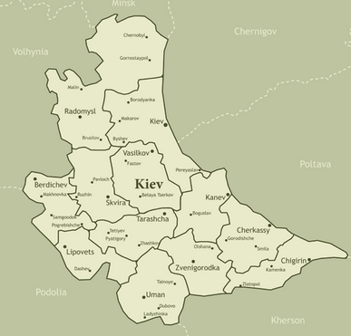
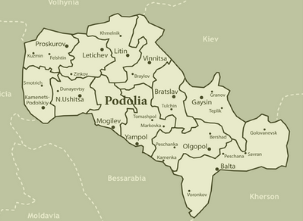

Slide 15
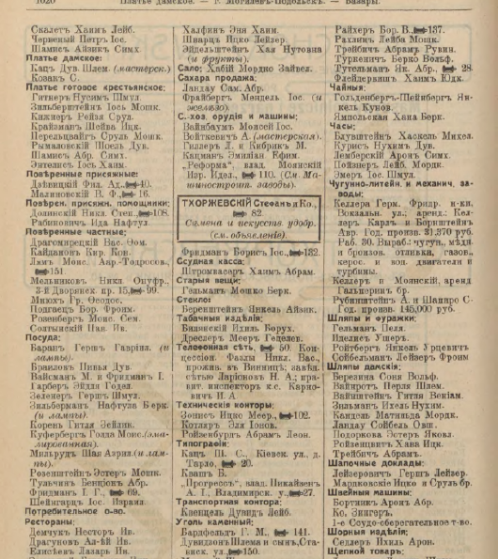

Slide 16
1913 Business Directory
Thanks to Alan Shuchat for managing this project, recruiting and coordinating volunteers and doing much of the translations himself
1913 business directory of the southwest provinces of the Russian Empire
This database contains 2053 Jewish names from Mogilev-Podol’skiy, Ol'gopol', Pogrebishche, Tal'noe, and Zvenigorodka and its surrounding district (uezd), extracted from a 1913 directory of businesses in the provinces of Kiev, Podolia, and Volhynia.

Slide 17
How to get a project started
Mark Jacobson read the email announcement long ago about data acquisition from CAHJP. At the time he believed his family was from Belaya Tserkov. He got in touch with me and Chuck Weinstein and he became a Town Leader since he has lots of spare time (not)!
We discussed what was being acquired - for Belaya Tserkov there was the 1850 Revision List and updates from 1851 and 1852) and the 1816 Revision List that included the nearby towns of Vasilkov, Fastov, and Rokitno. Mark composed a proposal for JewishGen including the 19th century Jewish populations of the towns and brief historical information on the Jewish population, the number of researchers listing each town on JGFF, and information on the interest in Belaya Tserkov, particularly in Philadelphia where many immigrants from there settled.

Slide 18
Once the proposal was approved he contacted those listing the towns on JGFF, describing the project, and how much money was needed to acquire and index the records. He posted messages on the JGS Philadelphia Facebook page and also to other genealogy groups. Money was raised to acquire all the available records.
He was contacted by a few Russian born people with interest in the town who wanted to volunteer to index. Only one was approved, but for more than a year on particular translator, Tatyana, has been indexing 20 pages a month of the 1850 Revision and her work is excellent and appreciated. The recent addition of paid translator Marina has been a great boost to the project, she works quickly and consistently and has completed the entire 1816 Revision List in a short time. Her indexing also allowed Mark to raise more funds for translating from contributors who were excited to see so many records being indexed so quickly.

Slide 19
Until recently this project took Mark only a few hours a month, but recently there has been an increase in the number of translations and for the past couple of months he has been working at least 8 hours a week on this project.
Further research has revealed Mark’s family was not actually from Belaya Tserkov. He said “I realize the importance of this project for all who are researching their Jewish ancestors from the Ukraine and I want to see it through to the end. The most important thing is that we are indexing complete Revision Lists from one entire town. Until now most genealogists had to hire a researcher to examine the records and find information on just their family. Now they can see the entire town, their immediate family, extended family, neighbors, etc. Most Jews in the Russian Empire were mobile, moving often and not always living in their Revision town. This project will allow people to find their family who might have lived in one town but were registered for the Revision in Belaya Tserkov. One contributor recently thanked me because we identified his ancestor in the 1816 Revision List while a paid researcher had failed to find him. That makes this project worthwhile.”

